Slide 1

Week 09 Measurement of Variables: Operational Definition, Scaling, Reliability, Validity
Masters of Information Systems & Technology
MIS 6220 RESEARCH METHODS
_{BY}
Prof. Jimmy K.N.Macharia,
Associate Professor of Information Systems &Technology, and
Dean, School of Science & Technology,
_{kmacharia@usiu.ac.ke}

Slide 2
Measurement
Measurement of Variables:
Operational Definition
Measurement of Variables:
Scaling,
Reliability,
Validity

Slide 3
Conceptual Variables
Measured Variables
The ideas that form the basis of
a research hypothesis. Usually
stated in abstract manner.
Actual numbers that represent the
conceptual variables.
Study Time
Hours of Study
e.g. 1 hours, 2 hours…
Number of presses of a
button that administers
shock to another Ps.
Aggression
Operational Definition
Self-esteem
Rosenberg’s SE scale

Slide 4
Converging Operation
Operational Definition
A precise statement of how a conceptual variable is turned into
a measured variable.
Number of negative words
used in a creative story
CULTURE
Depression
Depression scale
Number of Appointments with
a psychotherapist

Slide 5
Measurement
Measurement:
the assignment of numbers or other symbols to characteristics (or attributes) of objects according to a pre-specified set of rules.

Slide 6
(Characteristics of) Objects
Objects
include persons, strategic business units, companies, countries, kitchen appliances, restaurants, shampoo, yogurt and so on.
Examples of characteristics
of objects are arousal seeking tendency, achievement motivation, organizational effectiveness, shopping enjoyment, length, weight, ethnic diversity, service quality, conditioning effects and taste.

Slide 7
Measurement Concepts
Operational Definition: is the definition of a variable in terms of the actual procedures used by the researcher to measure and/or manipulate it.
Similar to a ‘recipe,’ operational definitions specify exactly how to measure and/or manipulate the variables in a study.
Good operational definitions define pro-cedures precisely so that other researchers can replicate the study.

Slide 8
Operational Definitions
Impulsivity was operationalized as the total number of incorrect stimulus responses
Two doses of alcohol were used:
5g/kg and 10g/kg
Alcohol dependence vulnerability was defined as the total score on the Michigan Alcohol Screening Test (MAST; Selzer, 1971)

Slide 9
Measurement Error
A participant’s score on a particular measure consists of 2 components:
Observed score = True score + Measurement Error
True Score = score that the participant would have obtained if measurement was perfect—i.e., we were able to measure without error
Measurement Error = the component of the observed score that is the result of factors that distort the score from its true value

Slide 10
Factors that Influence Measurement Error
Transient states of the participants:
(transient mood, health, fatigue-level, etc.)
Stable attributes of the participants:
(individual differences in intelligence, personality, motivation, etc.)
Situational factors of the research setting:
(room temperature, lighting, crowding, etc.)

Slide 11
Types of Variables
Two types of variables:
One lends itself to objective and precise measurement;
The other is more nebulous and does not lend itself to accurate measurement because of its abstract and subjective nature.

Slide 12
Types of Variables
Nominal Variable
Sex, Ethnicity, Region, Religion, School, Team, Experimental Condition
Name or Identity of
particular characteristics
Quantitative Variable
Perceived Attractiveness,
Number of Siblings
Self-Esteem
Independence/Interdependence
Numbers to indicate the
extent to which a person
possesses a characteristic
of interest.

Slide 13
Types of Variable and Types of Measurement
Number?
No
Yes
Quantitative Variable
Order?
Nominal Variable
Yes
Distance Matters?
No
Ordinal Scale
Yes
True Zero?
No
Interval Scale
Yes
Ratio Scale

Slide 14
Operationalizing Concepts
Operationalizing concepts:
reduction of abstract concepts to render them measurable in a tangible way.
Operationalizing
is done by looking at the behavioral dimensions, facets, or properties denoted by the concept.

Slide 15
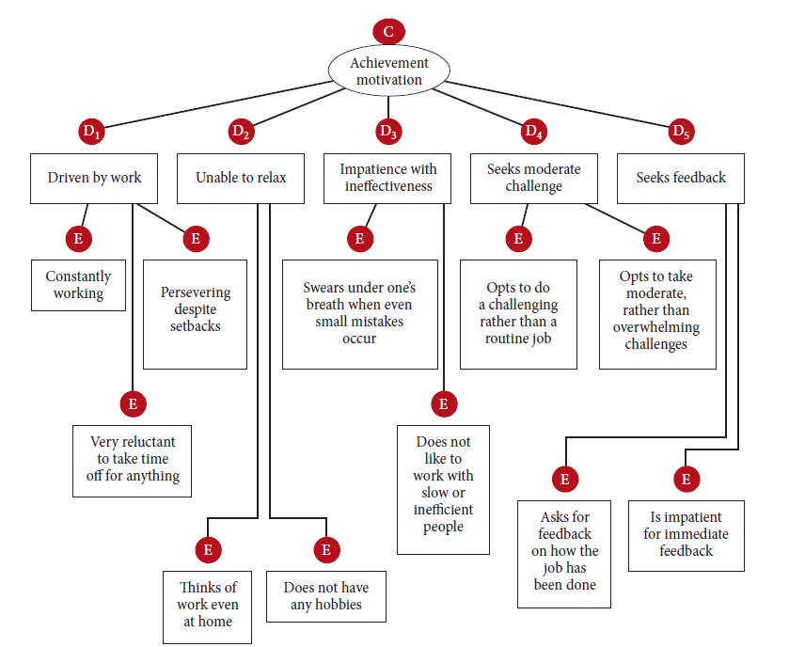
Example

Slide 16
Chapter 12
Measurement of Variables: Scaling, Reliability, Validity
16

Slide 17
Scale
Scale:
tool or mechanism by which individuals are distinguished as to how they differ from one another on the variables of interest to our study.

Slide 18
Nominal Scale
Classification of objects and placing them into specific categories (“Naming them”)
Tends to be more of a qualitative measure rather than a quantitative
There is no way to measure between the categories
Nominal Scale – Religious affiliation
Buddhist, Christian, Jewish, etc.

Slide 19
Nominal Scale
A nominal scale is one that allows the researcher to assign subjects to certain categories or groups.
What is your department?
O Marketing O Maintenance O Finance
O Production O Servicing O Personnel
O Sales O Public Relations O Accounting
What is your gender?
O Male
O Female

Slide 20
Nominal Scale
Buddhist
Protestant
Jewish
Catholic
Buddhist
Jewish
Catholic
Protestant

Slide 21
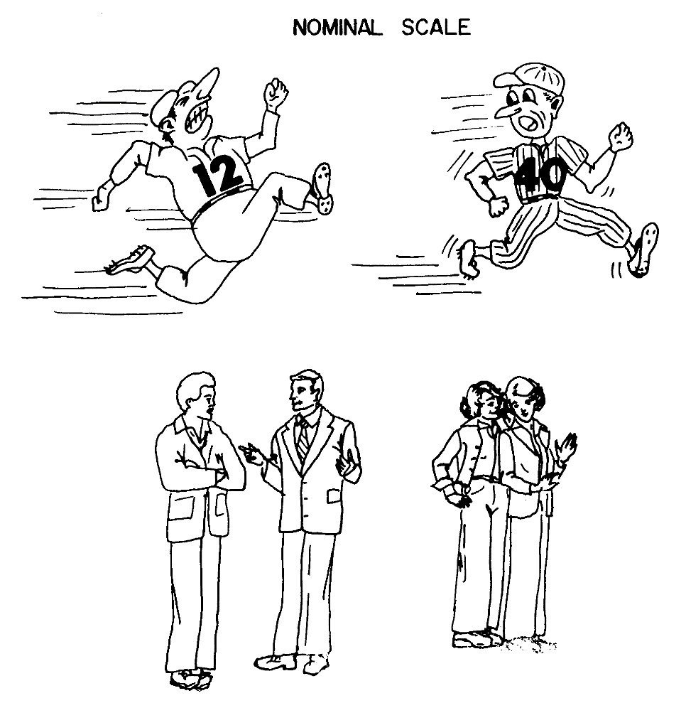
Nominal Scale

Slide 22
Ordinal Scale
Ordinal scale: not only categorizes variables in such a way as to denote differences among various categories, it also rank-orders categories in some meaningful way.
What is the highest level of education you have completed?
O Less than High School
O High School/GED Equivalent
O College Degree
O Masters Degree
O Doctoral Degree

Slide 23
Ordinal Scale
1st Born
2nd Born
3rd Born
Elastic Tape
1st Born
2nd Born
3rd Born
1st Born
3rd Born
2nd Born

Slide 24
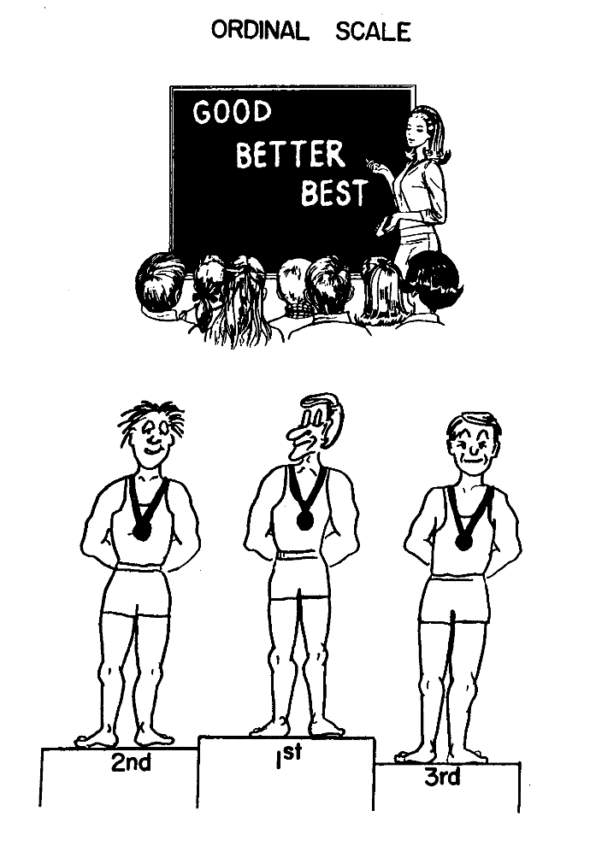
Ordinal Scale

Slide 25
Interval Scale
Interval scale:
whereas the nominal scale allows us only to qualitatively distinguish groups by categorizing them into mutually exclusive and collectively exhaustive sets, and the ordinal scale to rank-order the preferences, the interval scale lets us measure the distance between any two points on the scale.
Has the same properties as Ordinal scales, but also has equal distance between the units
But does not have an absolute zero point
Temperature is an easy example
Movement of one degree is equal across the scale

Slide 26
Interval scale
Circle the number that represents your feelings at this particular moment best. There are no right or wrong answers. Please answer every question.
1. I invest more in my work than I get out of it
I disagree completely 1 2 3 4 5 I agree completely
2. I exert myself too much considering what I get back in return
I disagree completely 1 2 3 4 5 I agree completely
3. For the efforts I put into the organization, I get much in return
I disagree completely 1 2 3 4 5 I agree completely

Slide 27
Interval Scale
0 10 20 30 40 50 60
- 10 0 10 20 30 40 50
0 10 20 30 40 50 60

Slide 28
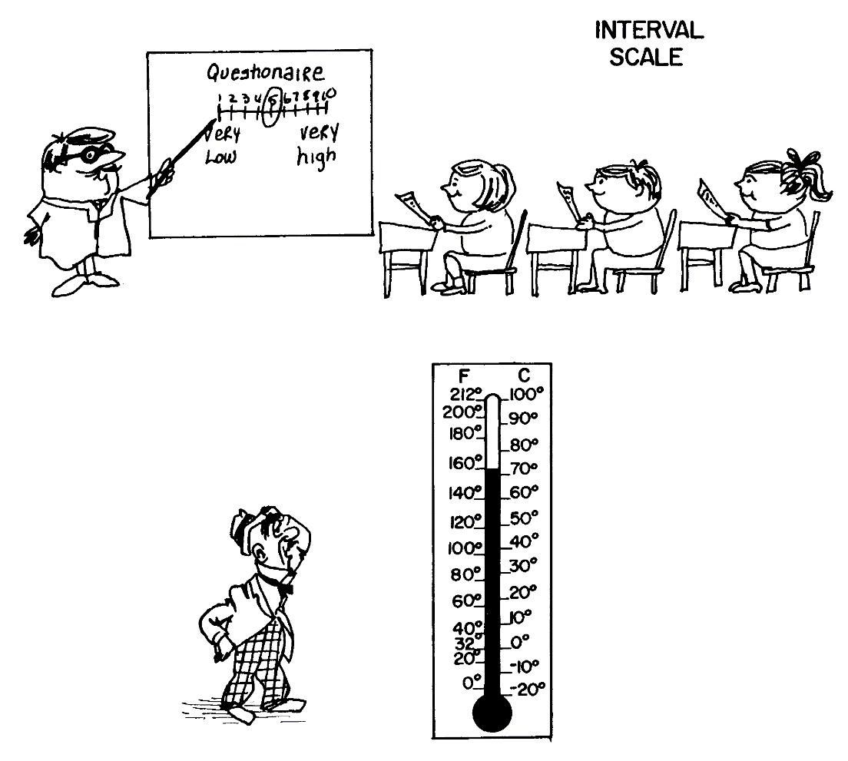
Interval scale

Slide 29
Ratio Scale
Ratio scale:
the disadvantage of the arbitrary origin point of the interval scale, in that it has an absolute (in contrast to an arbitrary) zero point, which is a meaningful measurement point.
Contains all the properties of interval scales but does contain an absolute zero point
Ratios allow for multiplication of factors on the scale
Scores may be twice or three times as high or lower than other scores
What is your age?

Slide 30
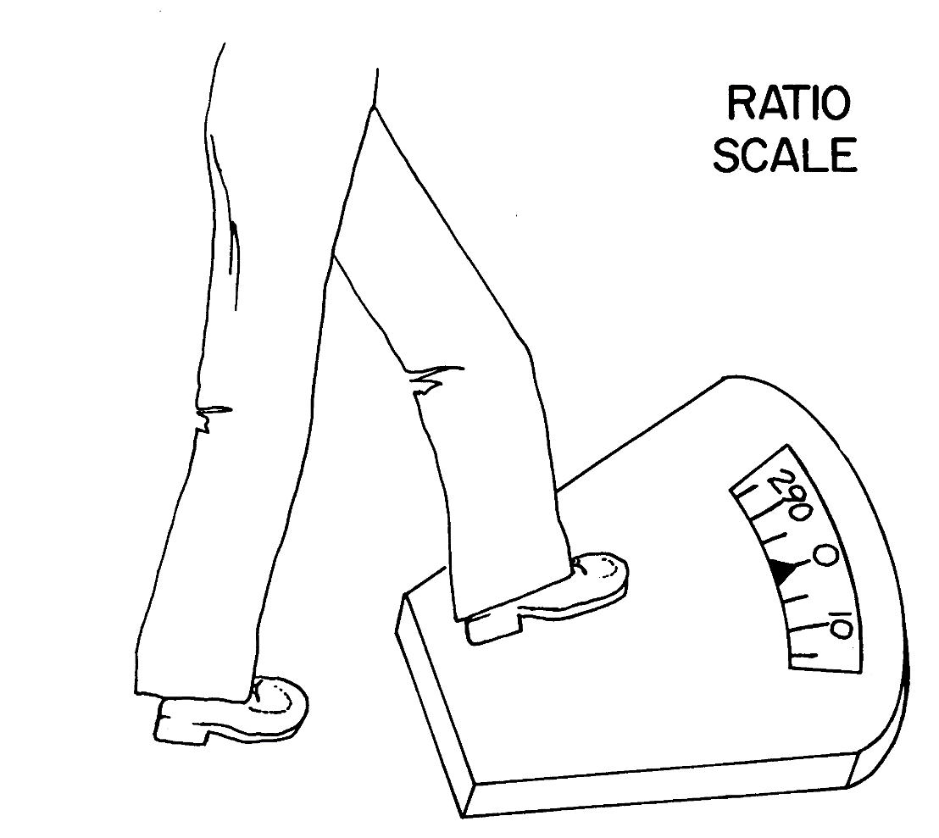
Ratio Scale

Slide 31
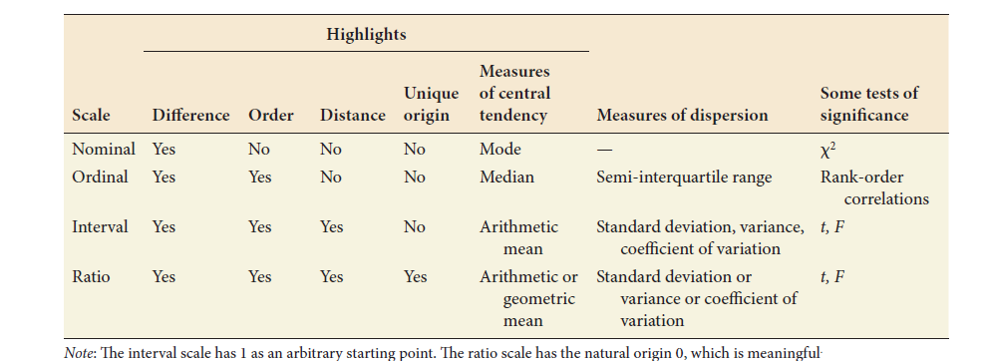
Properties of the Four Scales
Insert Table 12.1 here

Slide 32
So, which scale does
behavioral scientist use?
There is some disagreement about whether measured
variables in the behavioral sciences can be considered ratio or
interval scales or whether they should be considered only
ordinal scales.

Slide 33
Measures
Self-Report?
No
Behavioral Measures
Yes
Physiological?
Yes
Psychophysiological
Measures
Self-Report Measures
No
EEG, MRI, fMRI, PET, CAT
Format?
Yes
No
Attitudes?
Yes
Non-Reactive
Measures
Free Format
Self-Report
Measures
Fix Format
Self-Report
Measures
No
IAT
Observational
Measures
Projective Measures
The Likert Scale
Frequency, Duration,
Intensity Latency, Speed
Associative Measures
The Semantic Differential
Think-around Protocols
The Guttman Scale

Slide 34
Measures
Self-Report Measure
Individual are asked to respond to questions posed by an interviewer
or a questionnaire.
Behavioral Measures
Direct measures of what people
do.

Slide 35
Free Format Self-Report Measure
A measure that allows respondents
to indicate whatever thoughts or
feelings they have about the topic
without any constraints imposed
on respondents except the effort
it takes to write thoughts or feelings
down or speak them into a tape
recorder.

Slide 36
Projective Measures
A measure of personalities in which
an ambiguous stimuli, such as an
inkblot, is shown to participants who
are asked to freely list whatever come to
mind as they view image.
e.g. Thematic Apperception Test (TAT)
(Morgan & Murray, 1935)
e.g. Rorshach inkblots

Slide 37
Associative Lists
A measure that ask people
to respond to words or concepts
with whatever ideas that come to
mind.
e.g. Stereotype Research
(Stangor, Sullivan, & Ford, 1991)

Slide 38
Think-aloud Protocols
A measure that asks respondent
to say or write whatever they
are thinking about during the task.
The researcher usually records or
transcribes the verbal information.
e.g. Impression Formation
(Fiske, Neuberg, Beattie, &
Milberg, 1987)

Slide 39
The advantages and disadvantages of
Free-Format Measures.
It produces a rich set of data regarding the thoughts
and feelings of the people being studied.
It is non-reactive. People can respond without any
unnatural or artificial constraints.
X
It is very difficult and time-consuming to turn the
generated thoughts into a set of measured variables
that can be used in data analysis.
It is hard to compare individuals because each format
is uniquely generated.

Slide 40
Fixed-Format Self-Report Measures
On this measures, the individual
is presented with a set of questions
(called items), usually in the form
of rating scales. and responses that
can be given are more structured
than in free-format measures.
Strongly
Disagree
Strongly
Agree
Disagree
Agree

Slide 41
The Lickert Scale
Items that require respondents to indicate their degree of
agreement or disagreement with some opinions or beliefs
CULTURE
Example: Rosenberg’s self-esteem scale
I feel that I’m a person of worth, at least on any equal
base with others.
Strongly
Disagree
Can’t
decide
Strongly
Agree
Disagree
Agree
(2) At time I think I am no good at all (Reverse-Score)
Avoiding “Acquiescent Responding”

Slide 42
I enjoy making decisions on my own.
Agree
Disagree
Agree
1 2 3 4 5 6
Disagree
Agree
1 2 3 4 5 6 7 8 9
Disagree

Slide 43
Example. Tropp, & Wright (2000)
Please circle the pair of circle below that you feel best represents
your own level of identification with your group.
Self
Group
S
G
S
G
S
G
S
G
S
G
S
G

Slide 44
Semantic Differential Scale
(See Osgood, Suci, & Tannenbaum, 1957)
In this scale, the thing being evaluated is presented once at the
top of the page. The scale consist of pairs of adjectives
located at the two endpoints of a standard response format.
I think Al Gore is
Smart
Bad
Beautiful
Stupid
Good
Ugly

Slide 45
The Guttman Scale
A fixed-format self-report scale in which the items are arranged
in a cumulative order such that it is assumed that if a respondents
endorses or answers correctly any one items, he or she will also
endorse or correctly answer all of the previous scale items.
1.Are you a boy or a girl?
2.Is this a boy or a girl?
3.Is this a man or a woman?
4.When you were a baby, were you a girl or a boy?
5.When you grow up, will you be a man or a woman?
6.Was this woman a boy or a girl when she was young?
X

Slide 46
Again, Let’s think about advantages and
disadvantages of self-report measures!
Relatively easy to construct and administer.
Allow the researcher to ask many questions in a short
period of time.
People may not always be able to accurately self-report on the causes of their behavior.
People may not have any incentive to complete the task.
People sometimes respond in ways that they think will make them look good (self-protection)
People often behave in ways that the experimenter expect them to do so (cooperative-responding)
People may simply tell a lie.
X
Reactivity

Slide 47
So, how can we get naturalistic data
that reflect the person’s natural beliefs
or behavior?
Use “Cover Story”. (Deceive participants into believing
the setting is natural.
Use unrelated filler or distracter items to throw the
participants off the track.
3. Use other measure such as behavioral measures.

Slide 48
Observational Measures
The researcher assesses concrete behaviors using audio-visual
devices.
Frequency (e.g. frequency of stuttering as a measure of
anxiety in interpersonal relations)
Duration (e.g. the number of minutes working at a task as
a measure of task interest)
Intensity (e.g. how hard a person claps his or her hands as a
measure of effort)
Latency (e.g. the number of days before a person begins to
work on a project as a measure of procrastination)
Speed (e.g. how long it takes a mouse to complete a maze
as a measure of learning ability)

Slide 49
Non Reactive Measures
Measurement that assess attitudes that are unlikely to be directly expressed on self-report measures, such as racial prejudice, homosexuality, and so on.
Let’s compare other measure regarding prejudice….
Modern Racism Scale…
Implicit Association Test…

Slide 50
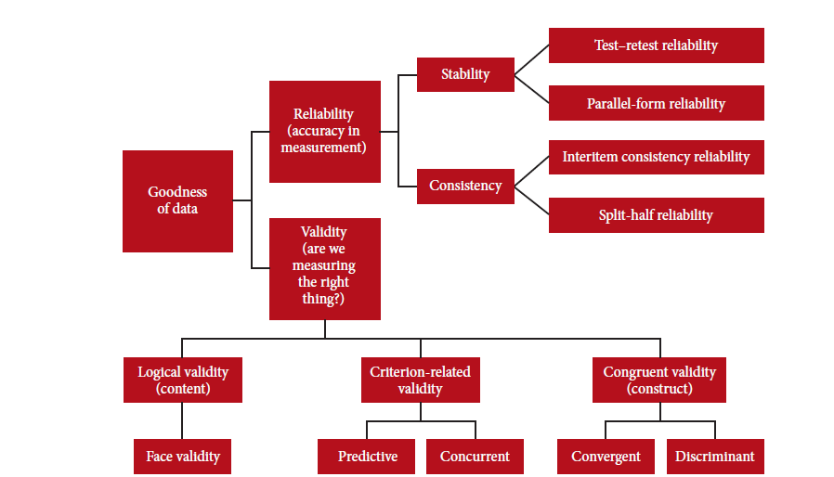
Goodness of Measures

Slide 51
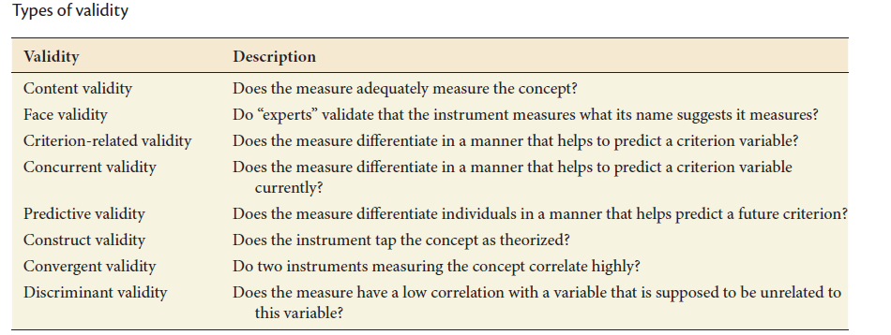
Validity

Slide 52
Estimating the Validity of a Measure
A good measure must not only be reliable, but also valid
A valid measure measures what it is intended to measure
Validity is not a property of a measure, but an indication of the extent to which an assessment measures a particular construct in a particular context—thus a measure may be valid for one purpose but not another
A measure cannot be valid unless it is reliable, but a reliable measure may not be valid

Slide 53
Estimating Validity
Like reliability, validity is not absolute
Validity is the degree to which variability (individual differences) in participant’s scores on a particular measure, reflect individual differences in the characteristic or construct we want to measure
Three types of measurement validity:
Face Validity
Construct Validity
Criterion Validity

Slide 54
Face Validity
Face validity refers to the extent to which a measure ‘appears’ to measure what it is supposed to measure
Not statistical—involves the judgment of the researcher (and the participants)
A measure has face validity—’if people think it does’
Just because a measure has face validity does not ensure that it is a valid measure (and measures lacking face validity can be valid)

Slide 55
Construct Validity
Most scientific investigations involve hypothetical constructs—entities that cannot be directly observed but are inferred from empirical evidence (e.g., intelligence)
Construct validity is assessed by studying the relationships between the measure of a construct and scores on measures of other constructs
We assess construct validity by seeing whether a particular measure relates as it should to other measures

Slide 56
Self-Esteem Example
Scores on a measure of self-esteem should be positively related to measures of confidence and optimism
But, negatively related to measures of insecurity and anxiety

Slide 57
Convergent and Discriminant Validity
To have construct validity, a measure should both:
Correlate with other measures that it should be related to (convergent validity)
And, not correlate with measures that it should not correlate with (discriminant validity)

Slide 58
Criterion-Related Validity
Refers to the extent to which a measure distinguishes participants on the basis of a particular behavioral criterion
The Scholastic Aptitude Test (SAT) is valid to the extent that it distinguishes between students that do well in college versus those that do not
A valid measure of marital conflict should correlate with behavioral observations (e.g., number of fights)
A valid measure of depressive symptoms should distinguish between subjects in treatment for depression and those who are not in treatment

Slide 59
Two Types of Criterion-Related Validity
Concurrent validity
measure and criterion are assessed at the same time
Predictive validity
elapsed time between the administration of the measure to be validated and the criterion is a relatively long period (e.g., months or years)
Predictive validity refers to a measure’s ability to distinguish participants on a relevant behavioral criterion at some point in the future

Slide 60
SAT Example
High school seniors who score high on the the SAT are better prepared for college than low scorers (concurrent validity)
Probably of greater interest to college admissions administrators, SAT scores predict academic performance four years later (predictive validity)

Slide 61
Reliability
Reliability of measure indicates extent to which it is without bias and hence ensures consistent measurement across time (stability) and across the various items in the instrument (internal consistency).
The reliability of a measure is an inverse function of measurement error:
The more error, the less reliable the measure
Reliable measures provide consistent measurement from occasion to occasion

Slide 62
Estimating Reliability
Total Variance = Variance due + Variance due
in a set of scores to true scores to error
Reliability = True-score / Total
Variance Variance
Reliability can range from 0 to 1.0
When a reliability coefficient equals 0, the scores reflect nothing but measurement error
Rule of Thumb: measures with reliability coefficients of 70% or greater have acceptable reliability

Slide 63
Different Methods for Assessing Reliability
Test-Retest Reliability
Inter-rater Reliability
Internal Consistency Reliability

Slide 64
Test-Retest Reliability
Test-retest reliability refers to the consistency of participant’s responses over time (usually a few weeks, why?)
Assumes the characteristic being measured is stable over time—not expected to change between test and retest

Slide 65
Inter-rater Reliability
If a measurement involves behavioral ratings by an observer/rater, we would expect consistency among raters for a reliable measure
Best to use at least 2 independent raters, ‘blind’ to the ratings of other observers
Precise operational definitions and well-trained observers improve inter-rater reliability

Slide 66
Internal Consistency Reliability
Relevant for measures that consist of more than 1 item (e.g., total scores on scales, or when several behavioral observations are used to obtain a single score)
Internal consistency refers to inter-item reliability, and assesses the degree of consistency among the items in a scale, or the different observations used to derive a score
Want to be sure that all the items (or observations) are measuring the same construct

Slide 67
Estimates of Internal Consistency
Item-total score consistency
Split-half reliability: randomly divide items into 2 subsets and examine the consistency in total scores across the 2 subsets (any drawbacks?)
Cronbach’s Alpha: conceptually, it is the average consistency across all possible split-half reliabilities
Cronbach’s Alpha can be directly computed from data

Slide 68
Estimating the Validity of a Measure
A good measure must not only be reliable, but also valid
A valid measure measures what it is intended to measure
Validity is not a property of a measure, but an indication of the extent to which an assessment measures a particular construct in a particular context—thus a measure may be valid for one purpose but not another
A measure cannot be valid unless it is reliable, but a reliable measure may not be valid

Slide 69
Stability
Stability:
ability of a measure to remain the same over time, despite uncontrollable testing conditions or the state of the respondents themselves.
Test–Retest Reliability:
The reliability coefﬁcient obtained with a repetition of the same measure on a second occasion.
Parallel-Form Reliability:
Responses on two comparable sets of measures tapping the same construct are highly correlated.

Slide 70
Internal Consistency
Internal Consistency of Measures is indicative of the homogeneity of the items in the measure that tap the construct.
Interitem Consistency Reliability: This is a test of the consistency of respondents’ answers to all the items in a measure. The most popular test of interitem consistency reliability is the Cronbach’s coefﬁcient alpha.
Split-Half Reliability: Split-half reliability reflects the correlations between two halves of an instrument.

